Slide 1
Version Control Systems and Dependency Management
COMP6100001 - Software engineering
Session 16
Kenny Jingga, S.Kom., M.T.

Slide 2
Session 16 – Version Control Systems and Dependency Management
Learning objectives
At the end of this session, students will be expected to be able:
Understand the Role and Types of Version Control Systems (VCS)
Learn Fundamental Git Concepts and Collaborative Workflows
Explore Advanced Git Features and Best Practices for Team Use
Understand Dependency Management and the "One-Version" Rule

Slide 3
Session 16 – Version Control Systems and Dependency Management
Content outline
Preface
Introduction to Version Control Systems (VCS)
Centralized vs Distributed VCS
Git Fundamentals
Collaborative Workflows in Git
Advanced Git Features
Dependency Management and the “One-Version” Rule
Best Practices for Using Version Control in Teams

Slide 4
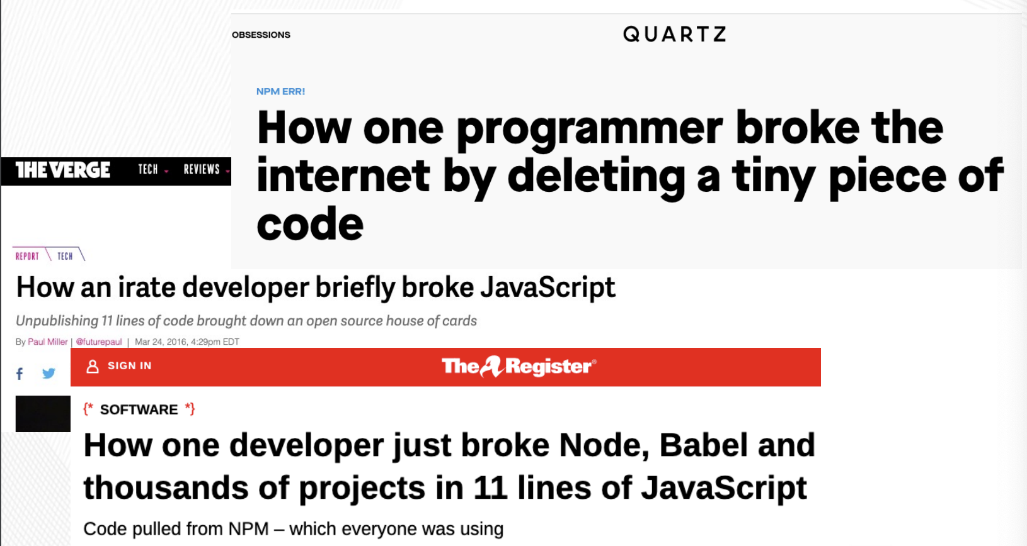
Preface
Left-pad (March 22, 2016)

Slide 5
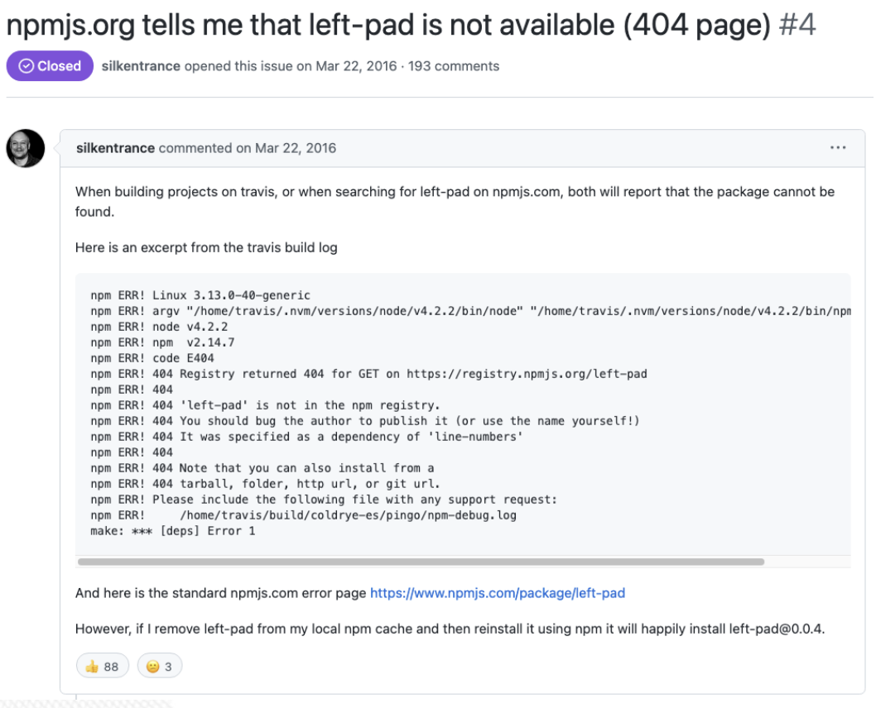
Preface
Left-pad (March 22, 2016)

Slide 6
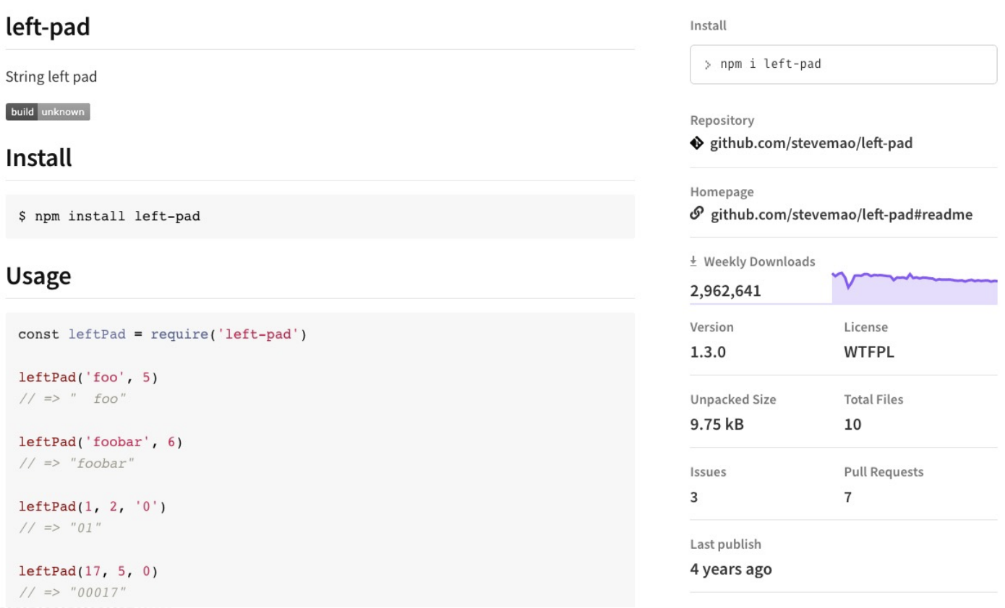
Preface
Left-pad (Docs)

Slide 7
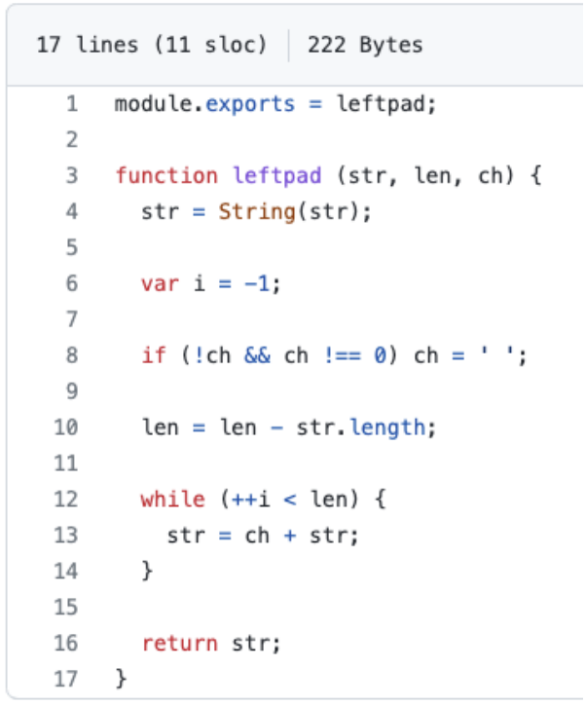
Preface
Left-pad (Source Code)

Slide 8

Introduction to Version control systems (VCS)
Definition and Importance
Version control combines procedures and tools to manage different versions of configuration objects that are created during the software process
Version Control System (VCS): A tool that helps manage changes to source code over time.
Importance:
  Tracks the history of changes.
  Facilitates collaboration among multiple developers.
  Enables rollback to previous versions if necessary.
  Supports branching and merging for parallel development.

Slide 9
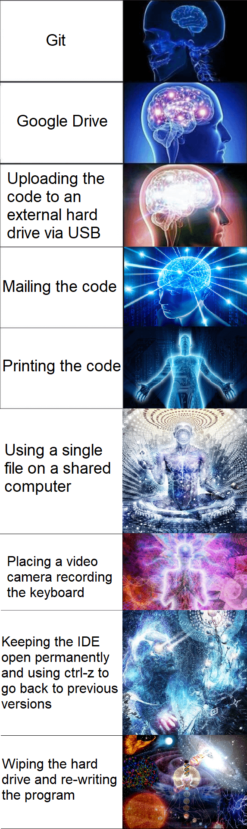
Introduction to Version control systems (VCS)
History and Evolution of VCS
First Generation:
  Local VCS like RCS (Revision Control System).
Second Generation:
  Centralized VCS like CVS (Concurrent Versions System) and SVN (Subversion).
Third Generation:
  Distributed VCS like Git and Mercurial.

Slide 10
Centralized vs Distributed VCS
Type of Version Control
Centralized Version Control System (CVCS)
Distributed Version Control System (DVCS)
Major architectural differences in version control system can make configuration, policy, and scaling decisions easier or more difficult

Slide 11
Centralized vs Distributed VCS
Centralized Version Control Systems (CVCS)
CVCS is a single central repository that all clients synchronize with
Although a developer can have files checked out and accessible on their local workstation, operations that interact on the version control status of those files need to be communicated to the central server (adding files, syncing, updating existing files, etc.). Any code that is committed by a developer is committed into that central repository
The first Version Control System implementations were all centralized Version Control Systems.
Examples: SVN, CVS.
Characteristics:
  Simplified administration.
  Single point of failure.
  Requires network access.

Slide 12
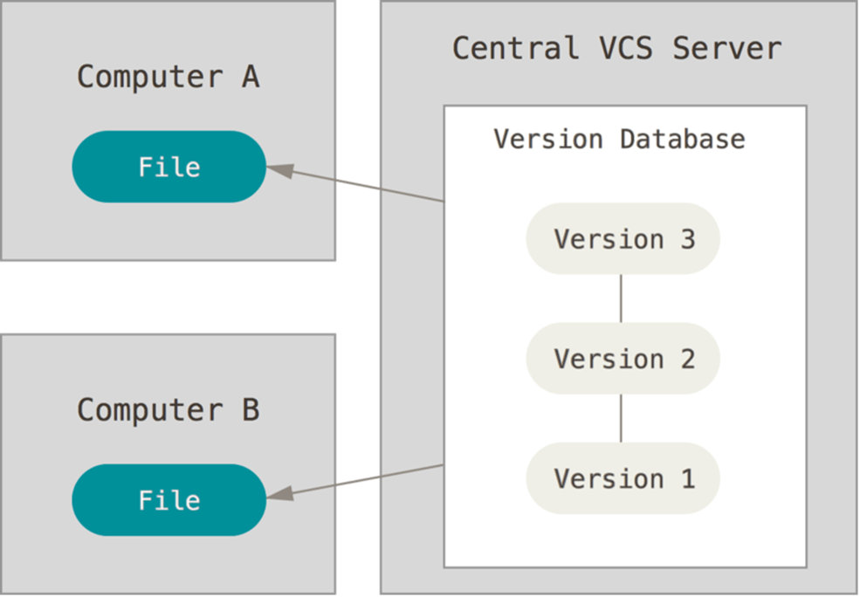
Centralized vs Distributed VCS
Centralized version control system

Slide 13
Centralized vs Distributed VCS
Distributed Version Control System (DVCS)
Each user has a local copy of the entire repository
A standard workflow is to clone some existing repository, make some edits, commit them locally, and then push some set of commits to another repository, which may or may not be the original source of the clone
Allows for better offline operation and collaboration without inherently declaring one particular repository to be the source of truth
Examples: Git, Mercurial.
Characteristics:
  Full history available locally.
  Supports offline work.
  Complex merging capabilities.

Slide 14
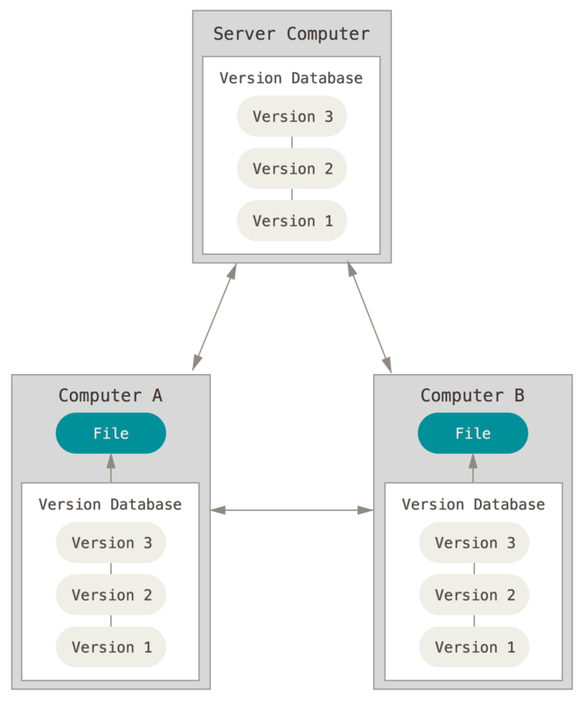
Centralized vs Distributed VCS
Distributed Version Control System

Slide 15
Centralized vs Distributed VCS
Comparison and Use Cases
Aspect | Centralized VCS | Distributed VCS
Repository | Single central server | Multiple local copies
Offline Access | Limited | Full
Collaboration | Sequential commits | Parallel development
Performance | Slower on operations | Faster due to local ops
Use Cases | Small teams, simple projects | Large projects, open source

Slide 16
Git Fundamentals
Repositories
Definition: A directory that stores your project's files and the entire history of changes.
Types:
  Local Repository: The repository on your local machine.
  Remote Repository: A repository hosted on a server (e.g., GitHub, GitLab).

Slide 17
Git Fundamentals
Commits
Definition: A snapshot of your repository at a specific point in time.
Components:
  Commit Message: Describes the changes made.
  Commit Hash: A unique identifier.

Slide 18
Git Fundamentals
Branches
Definition: A movable pointer to a commit, allowing parallel development.
Common Branches:
  Master/Main: The default branch.
  Feature Branches: For developing new features.

Slide 19
Git Fundamentals
Merges
Definition: Combining changes from different branches.
Types:
  Fast-Forward Merge: When there are no diverging changes.
  Three-Way Merge: When branches have diverged.

Slide 20
Collaborative Workflows in Git
Forking workflow
Process:
  Fork the repository.
  Make changes in your fork.
  Submit a pull request to the original repository.
Use Cases: Open-source projects, external contributors.

Slide 21
Collaborative Workflows in Git
Feature Branch Workflow
Process:
  Create a new branch for each feature.
  Merge back into the main branch after completion.
Benefits: Isolates work, simplifies code reviews.

Slide 22
Collaborative Workflows in Git
Gitflow Workflow
Structure:
  Master/Main Branch: Contains production-ready code.
  Develop Branch: Integrates features for the next release.
  Feature Branches: For developing new features.
  Release Branches: Prepare for production release.
  Hotfix Branches: For critical fixes in production.

Slide 23
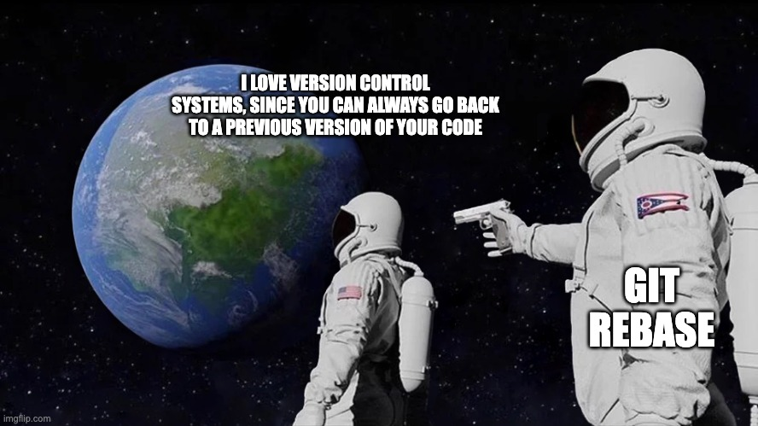
Advanced Git Features
Rebasing
Definition: Reapply commits on top of another base tip.
Use Cases: Maintain a linear project history.
Commands:
  git rebase

Slide 24
Advanced Git Features
Stashing
Definition: Temporarily save changes that are not ready to be committed.
Commands:
  git stash
  git stash apply

Slide 25
Advanced Git Features
Cherry-Picking
Definition: Apply a specific commit from one branch onto another.
Use Cases: Bring bug fixes into other branches.
Commands:
  git cherry-pick <commit-hash>

Slide 26
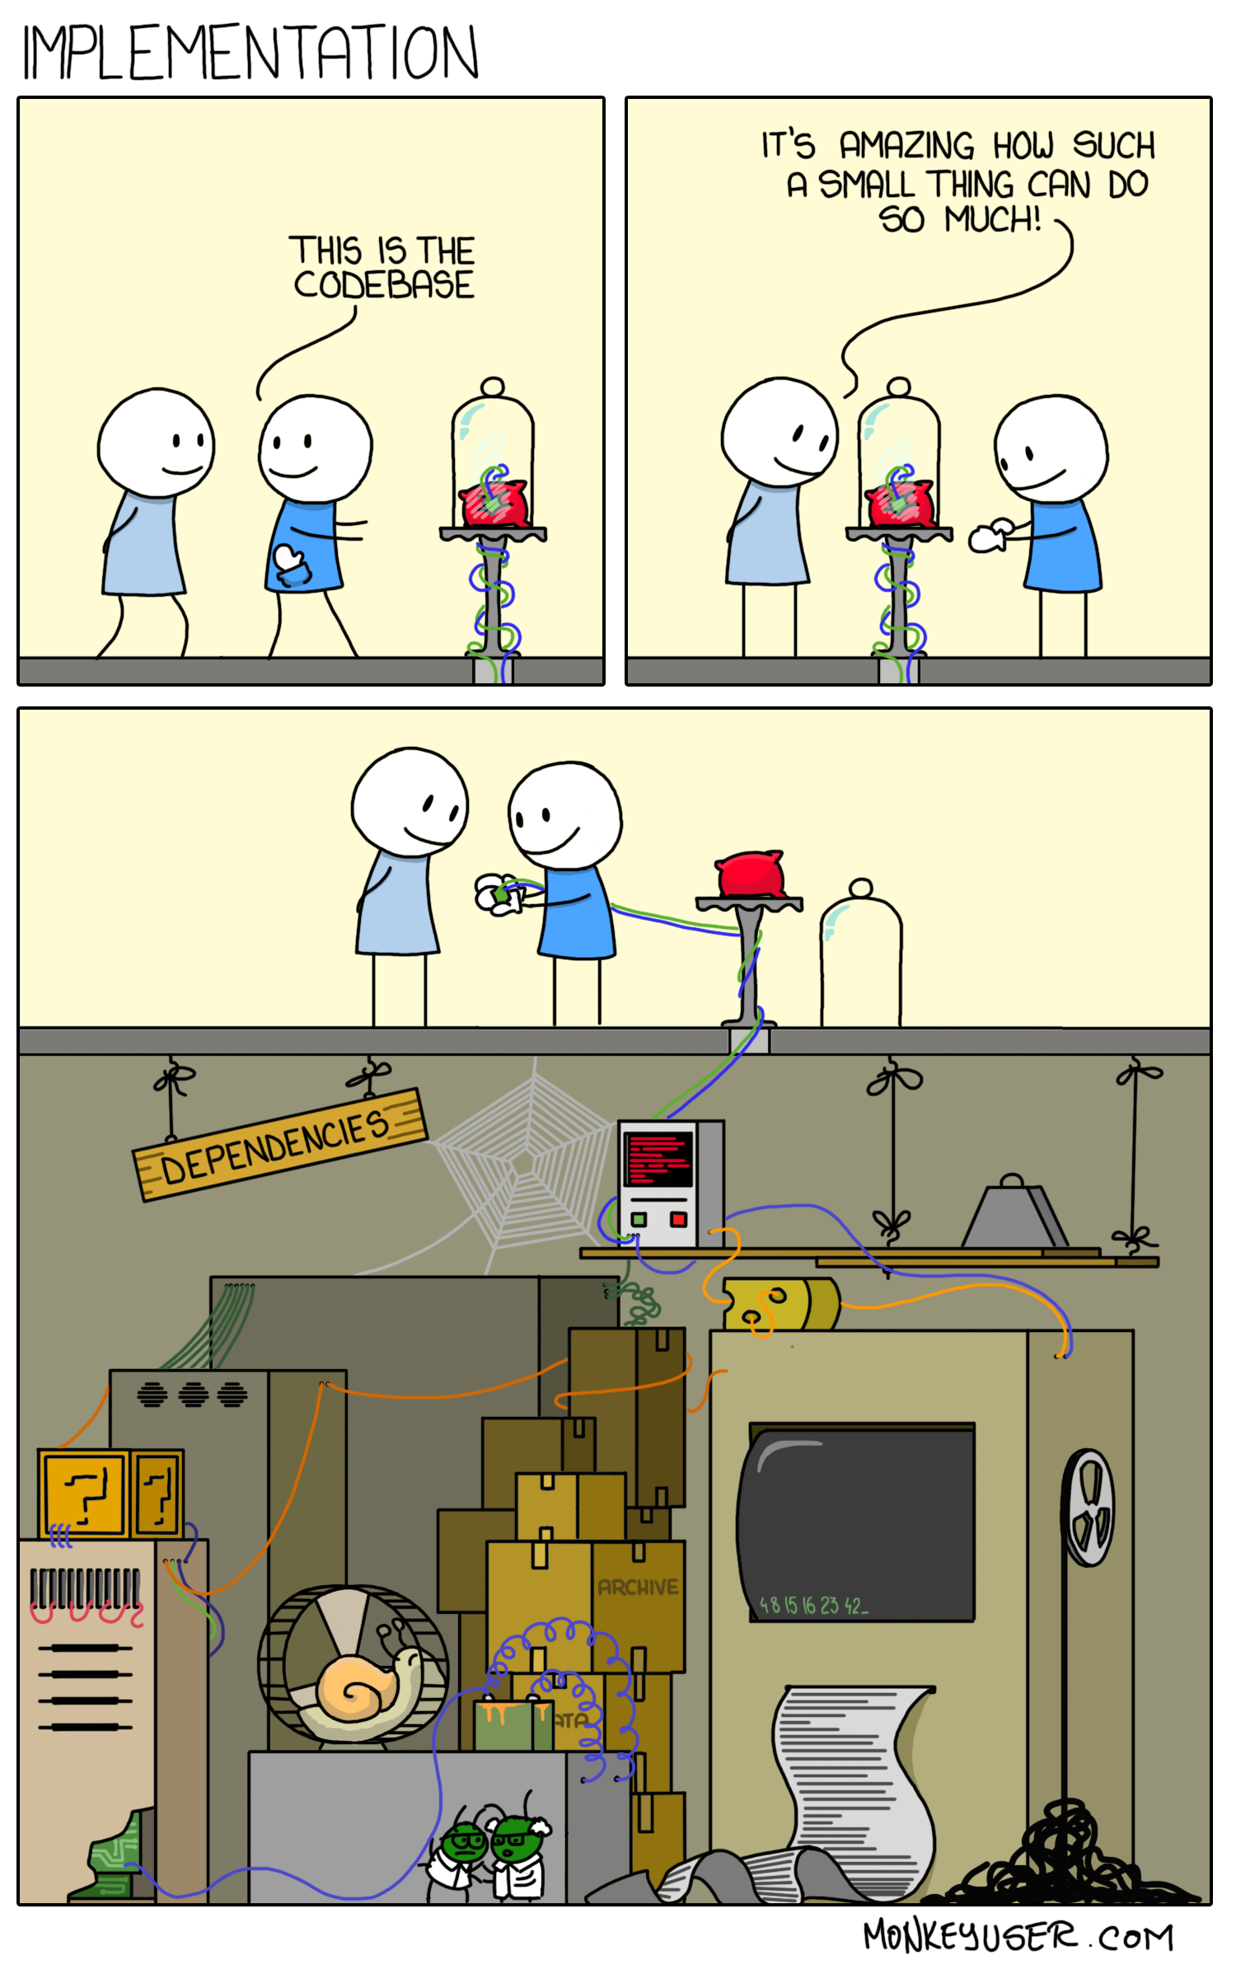
Dependency Management and the "One-Version" Rule
Dependency Management
It’s hard
It’s mostly a mess (everywhere)
But it’s critical to modern software development

Slide 27
Dependency Management and the "One-Version" Rule
What is a dependency?
Definition: External code or libraries that a project relies on.
Core of what most build systems do
  “Compile” and “Run Tests” is just a fraction of their job
Foo→Bar: To build Foo, you may need to have a built version of Bar
Dependency Scopes:
  Compile: Foo uses classes, functions, etc. defined by Bar
  Runtime: Foo uses an abstract API whose implementation is provided by Bar (e.g. logging, database, network or other I/O)
  Test: Foo needs Bar only for tests (e.g. JUnit, mocks)
Internal vs. External Dependencies
  Is Bar also built/maintained by your org or is it pulled from elsewhere using a package manager?
  Internal Dependencies: Code from within the organization.
  External Dependencies: Third-party libraries.

Slide 28
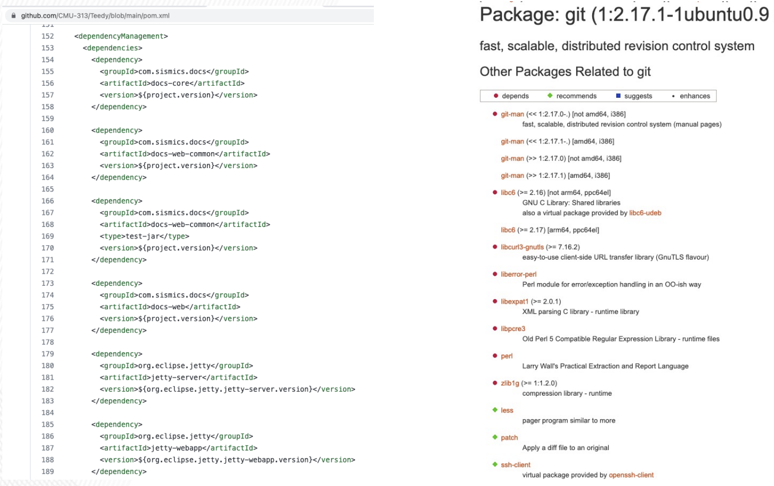
Dependency Management and the "One-Version" Rule
Dependencies: Example

Slide 29
Dependency Management and the "One-Version" Rule
Where are the Dependencies hosted?
Typically downloaded from dependency servers:
  Maven Central (https://repo.maven.apache.org/maven2/)
  Ubuntu Packages for Apt (https://packages.ubuntu.com/)
  Python Package Index (https://pypi.org/)
  NPM Public Registry (https://registry.npmjs.org/)
Packages need a unique identifier
  Typically a package name (sometimes owner name) and version
Custom repositories allowed by most package managers
  Often used for company-internal packages or cache mirroring
  Note problems with duplicates (same package name in different repositories; some priority order is needed)
Somebody needs to manage repositories
  Availability: Repository needs to be running
  Access Control: Packages should only be published by owners
  Integrity: Packages should be signed or otherwise verifiable
  Uniqueness and archival: Only one artifact per version
  Traceability: Packages can have metadata pointing to source or tests
  Security: ???

Slide 30
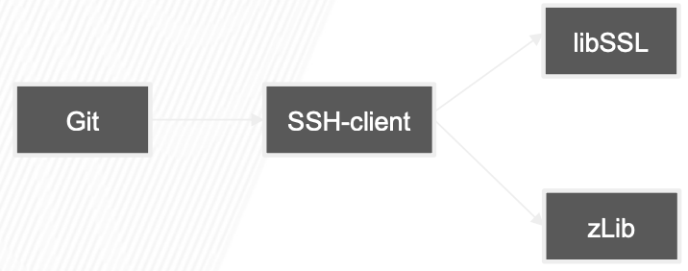
Dependency Management and the "One-Version" Rule
Transitive Dependencies
Packages can depend on other packages
Q: Should Git be able to use exports of libSSL (e.g. certificate management) or zLib (e.g. gzip compression)?

Slide 31
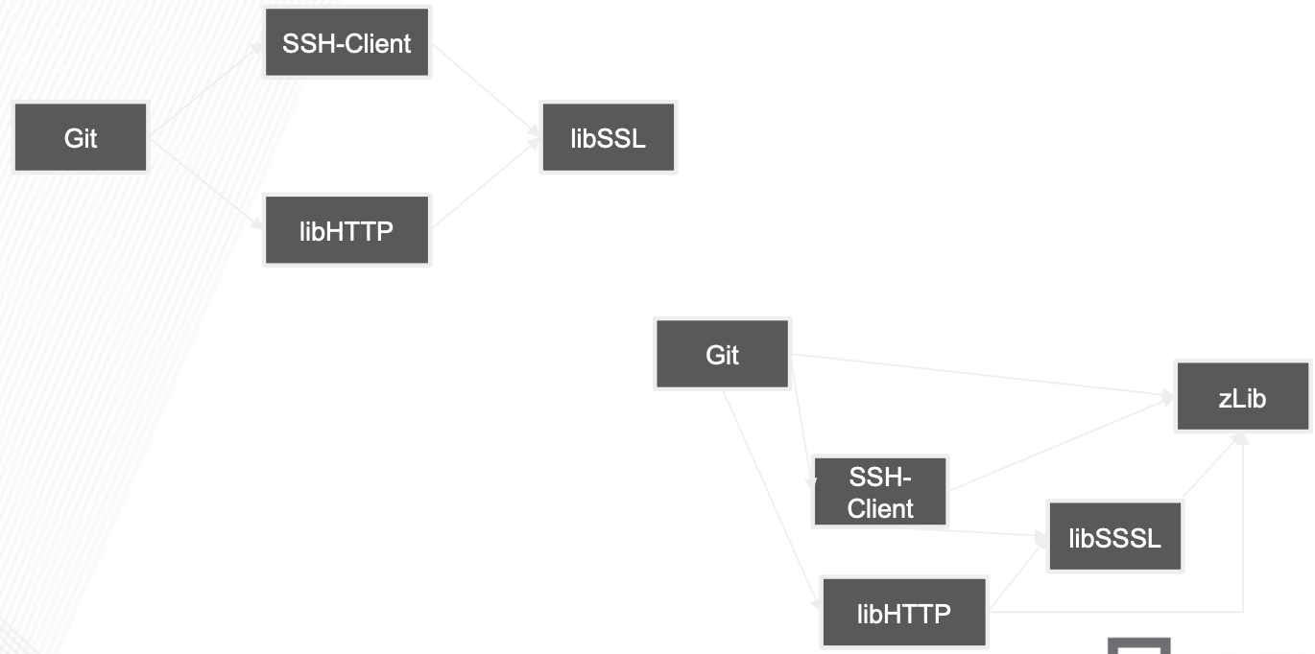
Dependency Management and the "One-Version" Rule
Diamond Dependencies
What are some problems when multiple intermediate dependencies have the same transitive dependency?

Slide 32
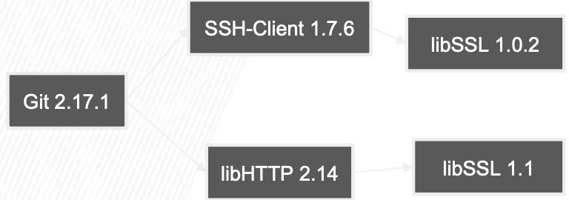
Dependency Management and the "One-Version" Rule
Diamond Dependencies
What are some problems when multiple intermediate dependencies have the same transitive dependency?

Slide 33
Dependency Management and the "One-Version" Rule
Resolutions to the Diamond PRoblem
Duplicate it!
  Doesn’t work with static linking (e.g. C/C++), but may be doable with Java (e.g. using ClassLoader hacking or package renaming)
  Values of types defined by duplicated libraries cannot be exchanged across
Ban transitive dependencies; just use a global list with one version for each
  Challenge: Keeping things in sync with latest
  Challenge: Deciding which version of transitive deps to keep
Newest version (keep everything at latest)
  Requires ordering semantics
  Intermediate dependency may break with update to transitive
Oldest version (lowest denominator)
  Also requires ordering semantics
  Sacrifices new functionality
Oldest non-breaking version / Newest non-breaking version
  Requires faith in tests or semantic versioning contract

Slide 34
Dependency Management and the "One-Version" Rule
The “One-Version” Rule
Definition: All code in the codebase should depend on exactly one version of any particular dependency.
Developers must never have a choice of “What version of this component should I depend upon?”
“One-Version” is not hard and fast, but phrasing this around limiting the versions that can be chosen when adding a new dependency conveys a very powerful understanding
Consistency has a profound importance at all levels in an organization
Benefits:
  Simplifies builds and deployments.
  Reduces conflicts and incompatibilities.
  Eases maintenance and updates.

Slide 35
Dependency Management and the "One-Version" Rule
Applying the Rule in Practice
Strategies:
  Monorepo Approach: Store all code in a single repository.
  Automated Dependency Updates: Use tools to keep dependencies up-to-date.
  Consistent Versioning: Align versions across projects.

Slide 36
Best Practices for Using Version Control in Teams
Commit Messages
Guidelines:
  Write clear, descriptive messages.
  Use imperative mood (e.g., "Add feature" not "Added feature").
  Include issue identifiers if applicable.

Slide 37
Best Practices for Using Version Control in Teams
Code Reviews
Purpose: Improve code quality and share knowledge.
Practices:
  Use pull requests for code reviews.
  Provide constructive feedback.

Slide 38
Best Practices for Using Version Control in Teams
Branching Strategies
Considerations:
  Choose a workflow that fits the team's needs.
  Keep branches short-lived to minimize conflicts.

Slide 39
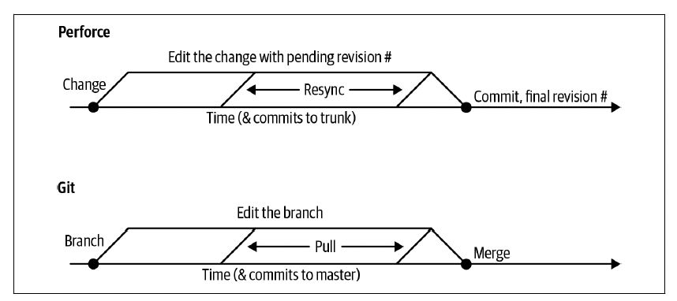
Best Practices for Using Version Control in Teams
Branch Management
Being able to track different revisions in version control opens up a variety of different approaches for how to manage those different versions -> branch management

Slide 40
Best Practices for Using Version Control in Teams
Continuous Integration and Continuous Deployment (CI/CD)
Integration with VCS:
  Trigger builds and tests on commits.
  Automate deployments from the repository.

Slide 41
References
Titus Winters, Tom Manshreck, and Hyrum Wright. (2020). Software Engineering at Google: Lesson Learned from Programming Over Time. 1st. O’Reilly Media. California. ISBN: 978-1492082798.
Roger Pressman and Bruce Maxim. (2020). Software Engineering: A Practitioner's Approach. 9th. McGraw Hill. New York. ISBN: 978-1259872976.
Ian Sommerville. (2016). Software Engineering. 10th. Pearson. London. ISBN: 978-1-292-09613-1.
GIT: https://git-scm.com/book/en/v2/Getting-Started-About-Version-Control
GitHub Guides: https://guides.github.com/

